Slide 1
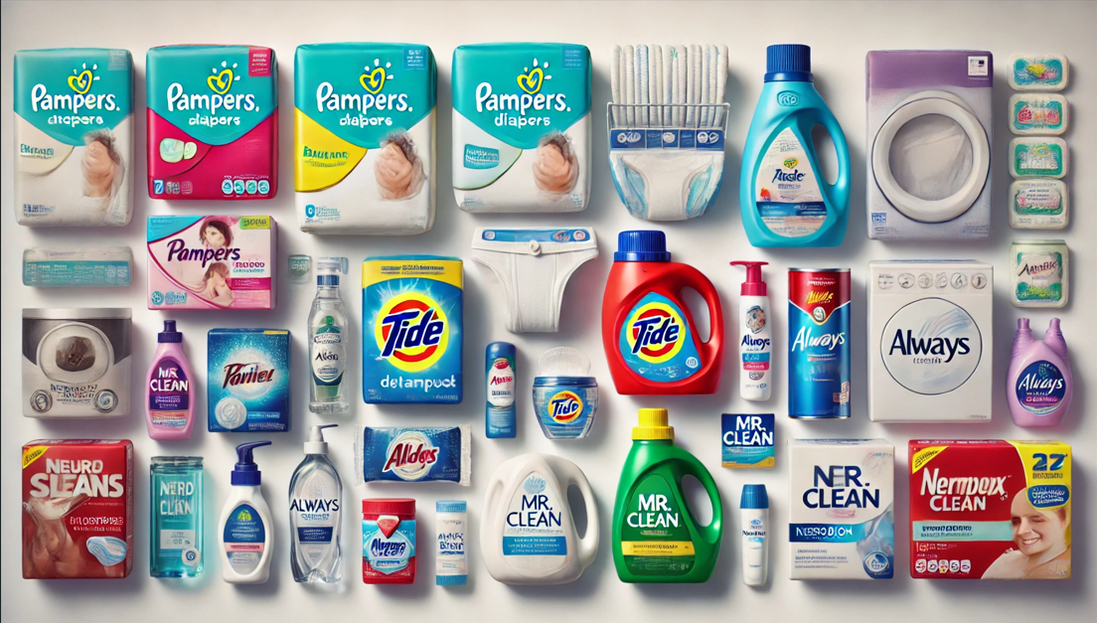
Comprehensive Sales and Campaign Analysis for F&K
Leveraging Data Insights for Strategic Decision-Making
Name: Taiwo Eniola

Slide 2
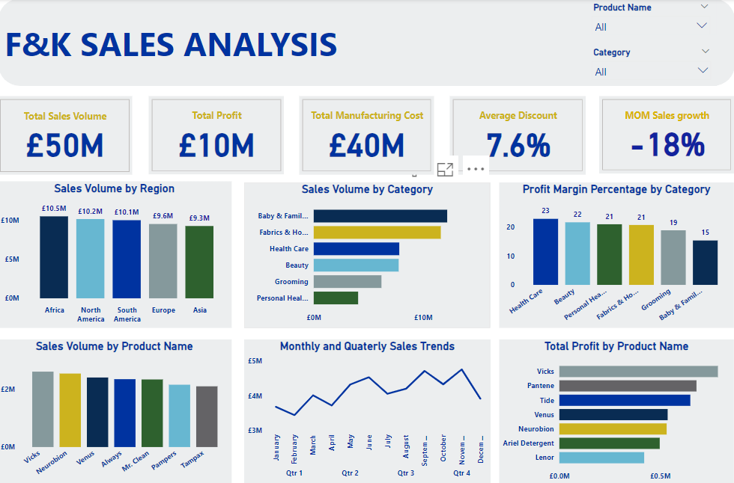

Slide 3
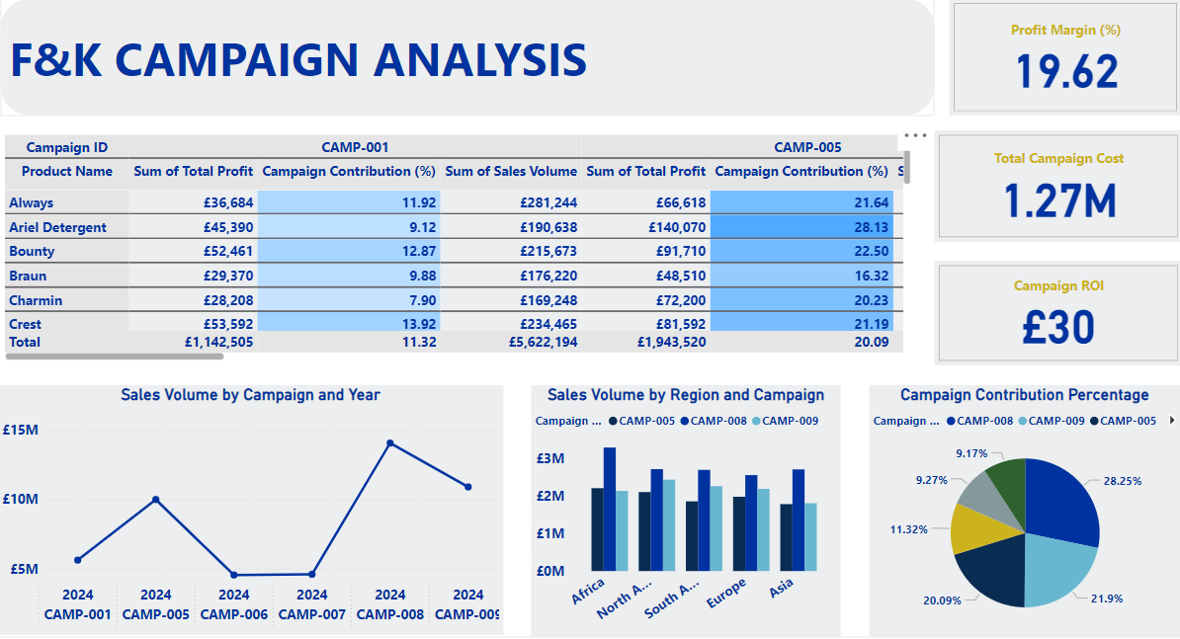

Slide 4
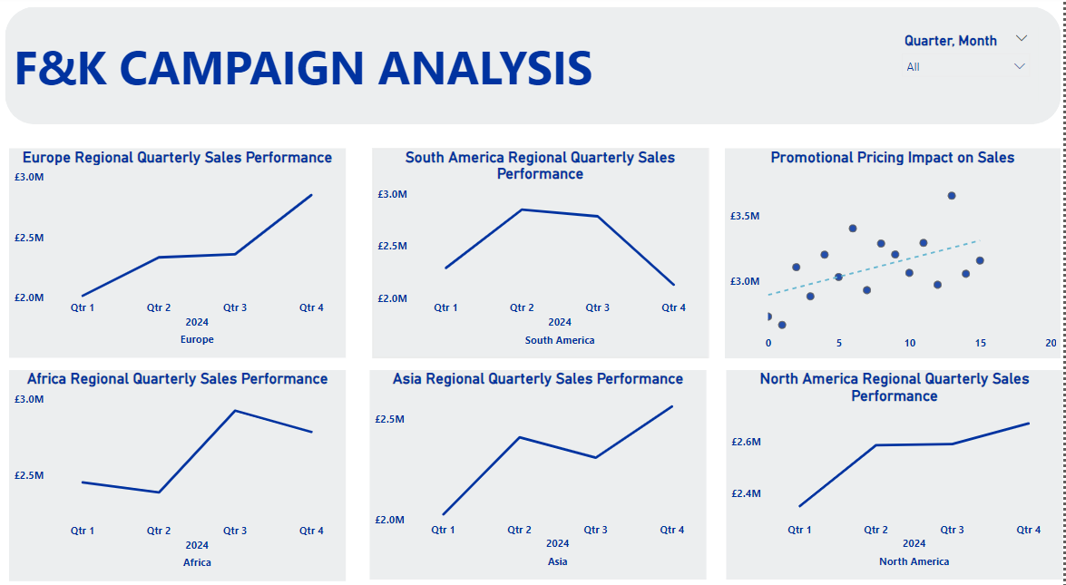

Slide 5
PROBLEM STATEMENT
Frocter & Kamble (F&K) is a leading multinational company with diverse product lines across several categories and regions. Despite strong overall sales, the company faces the following challenges:
Profitability Concerns: Certain high-sales categories, like Baby & Family Care, have lower profit margins, while others with higher profit margins, such as Health Care, are underutilized.
Market Penetration Issues: Sales performance is uneven across regions, with Europe and Asia lagging behind Africa and the Americas, indicating untapped growth potential in these regions.
Campaign Effectiveness: While some campaigns perform exceptionally well (e.g., Campaign ID 008), others underperform in specific regions, such as Campaign ID 009 in Asia.
Portfolio Optimization: The product portfolio needs strategic decisions to sustain high-growth areas (Stars), optimize profitability (Cash Cows), and re-evaluate underperforming segments (Question Marks and Dogs).
Objective: Develop a data-driven approach to optimize profitability, enhance market penetration, and improve campaign targeting to support sustainable growth.

Slide 6
EXCECUTIVE SUMMARY
This analysis evaluates sales performance, profit distribution, and regional campaign effectiveness for a diverse product portfolio. The focus is to optimize profitability, identify underperforming markets, and develop actionable strategies to enhance market penetration and operational efficiency.
Key Findings:
Sales Performance Overview:
Total Sales Volume: 50 million units.
Total Profit: £10 million.
Average Discount: 7.6%.
Region Analysis
Profit Analysis
Campaign Effectiveness:
Quarterly and Monthly Trends:
BCG Matrix Insights:
Stars: Health Care (high sales, high profit margin).
Cash Cows: Baby & Family Care (high sales, low profit margin).
Question Marks: Personal Health Care (low sales, moderate profit margin).
Dogs: Grooming (low sales, low profit margin).
Ansoff's Matrix Analysis:
Market Penetration
Market Development
Product Development
Diversification

Slide 7
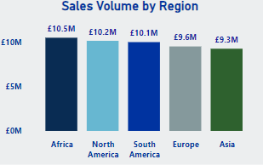
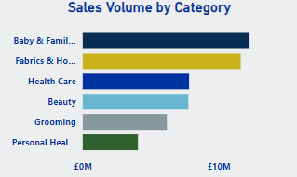
Sales Volume Overview
Region-wise sales Analysis:
Africa leads sales with 10.5M, followed by North America (10.2M) and South America (10M).
Europe (9.56M) and Asia (9.3M) have the lowest sales, despite the potential market size.
Insight: Campaigns should focus on Europe and Asia to boost market penetration. Africa's strong performance indicates successful campaign targeting and product alignment.
Sales by Product Category
Highest Sales Volume: Baby & Family Care (12.2M)
Lowest Sales Volume: Personal Health Care (6.19M).
Fabrics & Home Care (11.6M).

Slide 8
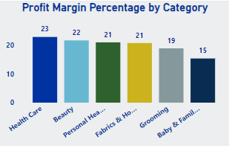
Product Category Profit Analysis
Baby & Family Care, despite high sales, contributes only 15.32% profit margin.
Health Care and Beauty categories offer higher profit margins (22.79% and 21.6%, respectively).
Return on Investment on Campaign: £30 per pound spent.
Actionable Insight: Improve margins in high-volume categories like Baby & Family Care by optimizing manufacturing costs or adjusting pricing strategies.

Slide 9
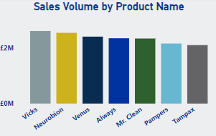
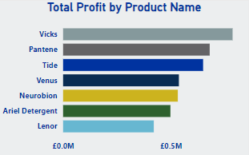
Top Performing Products
Sales Leaders:
Vicks (2.62M), Neurobion (2.55M), Venus (2.42M):
These products are driving the highest sales volumes, indicating strong market demand and effective positioning.
Vicks appears to cater to seasonal or health-related needs, making it a high-priority product to sustain top-line revenue.
Neurobion reflects consumer preference for personal health products, showcasing the potential for growth in health-related categories.
Venus suggests that grooming products have a consistent demand, which can be leveraged through promotions or complementary product bundling.
Profitability Leaders:
Vicks (£786,510), Pantene (£680,302), Tide (£649,695):
These products contribute significantly to overall profitability. Their consistent sales performance and favorable margins position them as key profit drivers.
Pantene’s profitability highlights the effectiveness of its branding and marketing strategies in the beauty segment.
Tide benefits from being a household staple, offering stability in long-term revenue generation.
Profit-to-Sales Efficiency:
Vicks stands out not only for sales volume but also for profitability, demonstrating an optimal balance between cost and revenue.
Tide and Pantene also exhibit a strong profit-to-sales ratio, emphasizing their strategic importance to the product portfolio.

Slide 10
Low Performing Product
Low Profitability Concerns &Optimization:
Always (£235,970 profit on high sales volume)
The low profit-to-sales ratio indicates a possible misalignment between pricing, manufacturing costs, or marketing expenses.
The product might be affected by competitive pricing or high production costs that erode margins.
Reassess the pricing strategy for Always and similar products to improve margins.
Explore cost reduction strategies, such as supplier renegotiations or process improvements, to lower production costs.
Evaluate the product’s positioning and consider introducing premium versions or bundling to add value.
Category-Level Analysis:
Conduct a deeper analysis of product categories with high sales but low profitability, such as Baby & Family Care, to identify inefficiencies.
For health-related products like Vicks and Neurobion, maintain competitive pricing while leveraging consumer trust to introduce new variants or complementary products.
Use successful strategies from Vicks and Pantene to guide underperforming products, focusing on branding, promotions, and customer engagement.
Consider phasing out consistently underperforming product lines that fail to align with overall profitability goals.
Prioritize marketing investments in Vicks, Pantene, and Tide to maximize profitability and market penetration.
Implement targeted campaigns for Vicks during high-demand seasons to enhance revenue further.

Slide 11
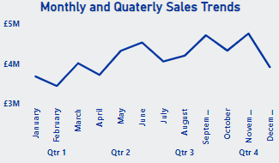
Monthly Sales Trend
Low-Performing Months:
High-Performing Months:
September (4.71M): Strong back-to-school campaigns or end-of-summer promotions boosted sales.
November (4.75M): Highest sales driven by early holiday shopping and promotional events like Black Friday.
February (3.44M): Post-holiday lull likely impacted sales as consumers recover from January spending.
December (3.91M): Despite being a peak shopping season, underperformance suggests potential missed opportunities in holiday promotions or market competition.
May (4.32M): Likely influenced by springtime marketing efforts or holiday-driven campaigns like Mother's Day.
Actionable Insights:
Analyse marketing strategies during peak months like November to replicate success in December.
Introduce tailored promotions for February, such as Valentine's Day sales or loyalty program bonuses, to boost consumer engagement.
Evaluate operational readiness and inventory during high-performing months to ensure smooth sales execution.

Slide 12
Quarterly Performance
Lower-Performing Quarters:
Strong Quarters:
Q3 (£13.02M): Consistent growth due to summer clearance sales and back-to-school shopping trends.
Q2 (£12.57M): Springtime campaigns and major holidays like Easter likely contributed to the performance.
Q4 (£12.17M): While November performed well, December's underwhelming sales pulled down the quarter's overall figures.
Q1 (£11.31M): Sales were likely impacted by reduced consumer spending post-Christmas and New Year.
Actionable Insights:
Develop Q1 campaigns that focus on post-holiday spending, such as New Year resolution-themed products or discounts on essentials.
Enhance Q4 by capitalizing on December’s missed opportunities with stronger Christmas marketing strategies or extended discounts beyond Black Friday.
Use predictive analytics to anticipate seasonal demand shifts and optimize inventory for peak sales months.

Slide 13
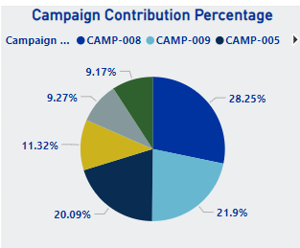
Campaign Contribution Overview
Top Contributor:
Campaign ID 008 contributed the highest at 28.25% to overall sales volume, indicating its strong appeal and successful execution.
Strengths: Effective targeting and well-aligned messaging with customer needs.
Campaign ID 009 contributed 21.9%, slightly lower but still significant, reflecting moderate regional reach and product-market alignment.
Campaign ID 005 achieved a contribution of 20.09%, signalling consistent results but potential for scaling.
Low Performers:
Campaigns with lower contributions require evaluation to identify gaps in strategy, targeting, or execution.
Moderate Performers:
Regional Campaign Breakdown
High Engagement Regions:
Africa: Campaign IDs 008 and 005 led with exceptional results, indicating a strong regional strategy and consumer interest in promoted products.
North America: Similar success with Campaign IDs 008 and 005, emphasizing successful localization of marketing efforts.
Underperforming Regions:
Asia: Campaign ID 009 underperformed significantly, highlighting challenges such as cultural misalignment, ineffective communication channels, or product relevance issues.

Slide 14
Campaign Actionable Insights
Leverage Success of Campaign ID 008:
Expand ID 008 to other regions or apply its successful strategies to future campaigns.
Conduct a detailed post-campaign analysis to document key drivers of its success (e.g., messaging, offers, product mix).
Optimize Underperforming Campaigns:
Focus on Campaign ID 009 to understand its lacklustre performance in Asia:
Evaluate cultural fit and relevance of the promoted products.
Investigate regional communication strategies, including language, media, and timing.
Adjust pricing, offers, or distribution channels to align with local market needs.
Tailor Regional Campaigns:
Africa and North America’s success suggests a robust understanding of consumer preferences. Use these insights to fine-tune strategies for underperforming regions.
For Asia, consider piloting smaller campaigns with localized adjustments to test effectiveness.
Invest in Data-Driven Decisions:
Implement sentiment analysis and customer segmentation tools to refine targeting.
Monitor real-time campaign performance metrics to enable agile adjustments during active campaigns.

Slide 15
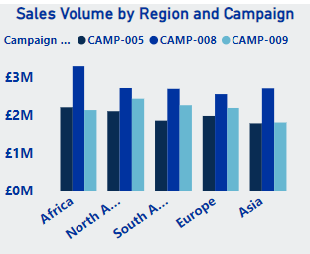
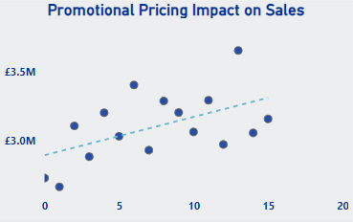
Product and Campaign Correlation
High Sales, Low Profit:
Products like Baby & Family Care have high volume but lower margins.
Insight: Explore cost-cutting or premium pricing strategies.
Promotional Pricing Impact:
Actionable Insight: Introduce targeted discount strategies for low-volume, high-margin products.
Positive correlation between discounts and sales volume (trendline slopes upward).

Slide 16
Strategic Recommendations
Campaign Strategy:
Invest in Campaign 008.
Revise poorly performing campaigns.
Profitability Focus:
Optimize manufacturing costs for Baby & Family Care.
Focus on high-margin categories like Health Care and Beauty.
Regional Expansion:
Strengthen presence in Europe and Asia.
Maintain momentum in Africa and North America.
Seasonal Marketing:
Target holiday seasons for improved December sales.

Slide 17

BCG Matrix Quadrants
Question Marks (Low Market Share, High Growth Potential): Category: Personal Health Care Analysis: Moderate profit margin (20.91%) but low sales volume (6.19M units). Indicates potential in a growing segment if proper strategies are implemented. Action Plan: Conduct market research to identify barriers to growth. Test new campaigns or products within this segment. Redirect resources from underperforming categories to stimulate growth.
Stars (High Market Share, High Growth Potential): Category: Health Care Analysis: Health Care products show high profitability (22.79% margin) and a substantial sales volume of 7.82M units. These products have the potential for sustained growth in competitive markets. Action Plan: Invest in expanding the product line. Increase marketing efforts to capture a larger market share. Ensure supply chain efficiency to meet growing demand.
Dogs (Low Market Share, Low Growth Potential): Category: Grooming Analysis: Low sales volume (6.19M units) and low profitability (18.84%). Struggles to compete with other categories. Action Plan: Reassess the value of retaining this category. Consider divestment or repositioning to niche markets. Explore partnerships or discontinuation of unprofitable products.
Cash Cows (High Market Share, Low Growth Potential): Category: Baby & Family Care Analysis: High sales volume (12.2M units) but a relatively low profit margin (15.32%). A mature category with stable demand, contributing consistently to overall revenue. Action Plan: Optimize manufacturing and operational costs to improve profitability. Explore price adjustments or premium variants to capture additional value. Use revenue from this category to fund growth opportunities in Stars and Question Marks.

Slide 18
Key Recommendations:
Evaluate Question Marks:
Prioritize R&D and marketing efforts in Personal Health Care to unlock growth potential.
Monitor performance closely and reassess investment strategies periodically.
Decide on Dogs:
Perform a detailed cost-benefit analysis for Grooming.
Consider reallocation of resources to higher-performing
Invest in Stars:
Double down on Health Care to sustain and increase growth.
Leverage insights from successful campaigns like Campaign ID 008, which aligns well with Star products.
Optimize Cash Cows:
Reduce operational inefficiencies in Baby & Family Care.
Develop cost-saving initiatives or explore premium product offerings.

Slide 19
Ansoff's Matrix
Market Development (Existing Products in New Markets)
Focus: Expand into new markets using current products.
Application:
Campaigns should target Asia and Europe, as these regions have lower sales volumes despite significant market potential.
Tailoring marketing strategies and localizing products could help address underperformance.
Example: Adapting successful strategies from Campaign ID 008 for underperforming regions.
Market Penetration (Existing Products in Existing Markets)
Focus: Increase sales in current markets using current products.
Application:
Regions like Africa and North America have high campaign engagement and sales volumes, indicating successful market penetration.
Further efforts could involve additional campaigns or promotions to solidify these gains in existing markets.
Product Development (New Products in Existing Markets)
Focus: Develop new products for current markets to meet emerging needs.
Application:
Baby & Family Care has high sales volume but low profit margins (15.32%). Introducing premium or value-added products could improve profitability.
Insights from categories with high profit margins, like Health Care (22.79%), can guide product innovation.
Diversification (New Products in New Markets)
Focus: Introduce new products into new markets.
Application:
Explore innovative product lines or strategic partnerships to enter untapped markets or customer segments.
Test campaigns in smaller regions or demographics to assess viability before large-scale rollouts.

